Slide 1
Maximum Mode

Slide 2
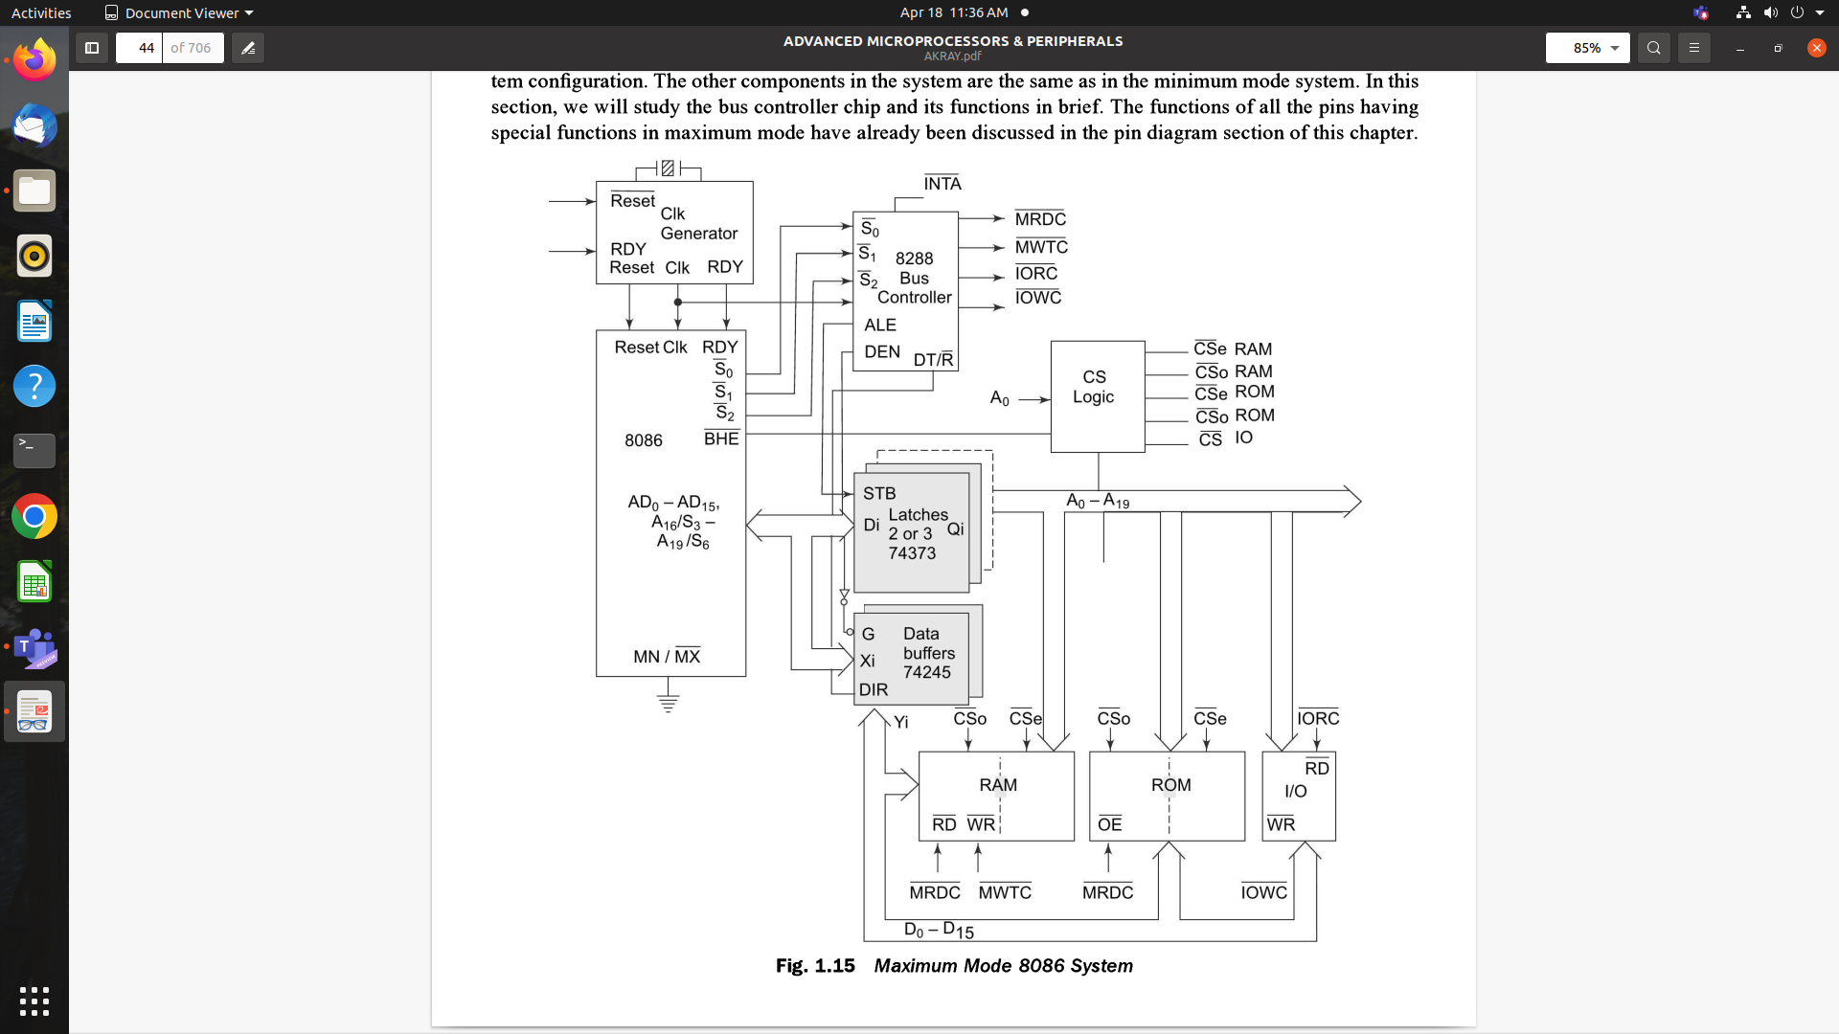

Slide 3
MN/ MX = ground
Processor derives status signals S0, S1, S2
Using status information, bus controller derives the control signals
> 1 microprocessor
Other components are same as that of minimum mode
Bus controller chip (8288) is an additional component

Slide 4
Using the information from status lines given by processor, derives control signals
RD, WR (for memory and IO devices), DEN, DT/R, ALE
Input to BC chip is S2, S1, S0 and CLK
Output to BC chip is ALE, DEN, DT/R, MRDC, MWTC, AMWC, IORC, IOWC, and AIOWC
AEN, IOB, CEN pins are used for multiprocessor modes
MCE/ PDEN depends upon the status of the IOB pin
IORC, IOWC - IO read and write
These signals enable an IO interface to read or write the data from or to the addressed port
MRDC, MWTC - memory read and memory write command signals
AIOWC, AMWTC are advanced signals of same memory read and write, activated one clock cycle earlier than IOWC, MWTC
The address/data and address/status timings are similar t minimum mode
ALE is asserted in T1.

Slide 5
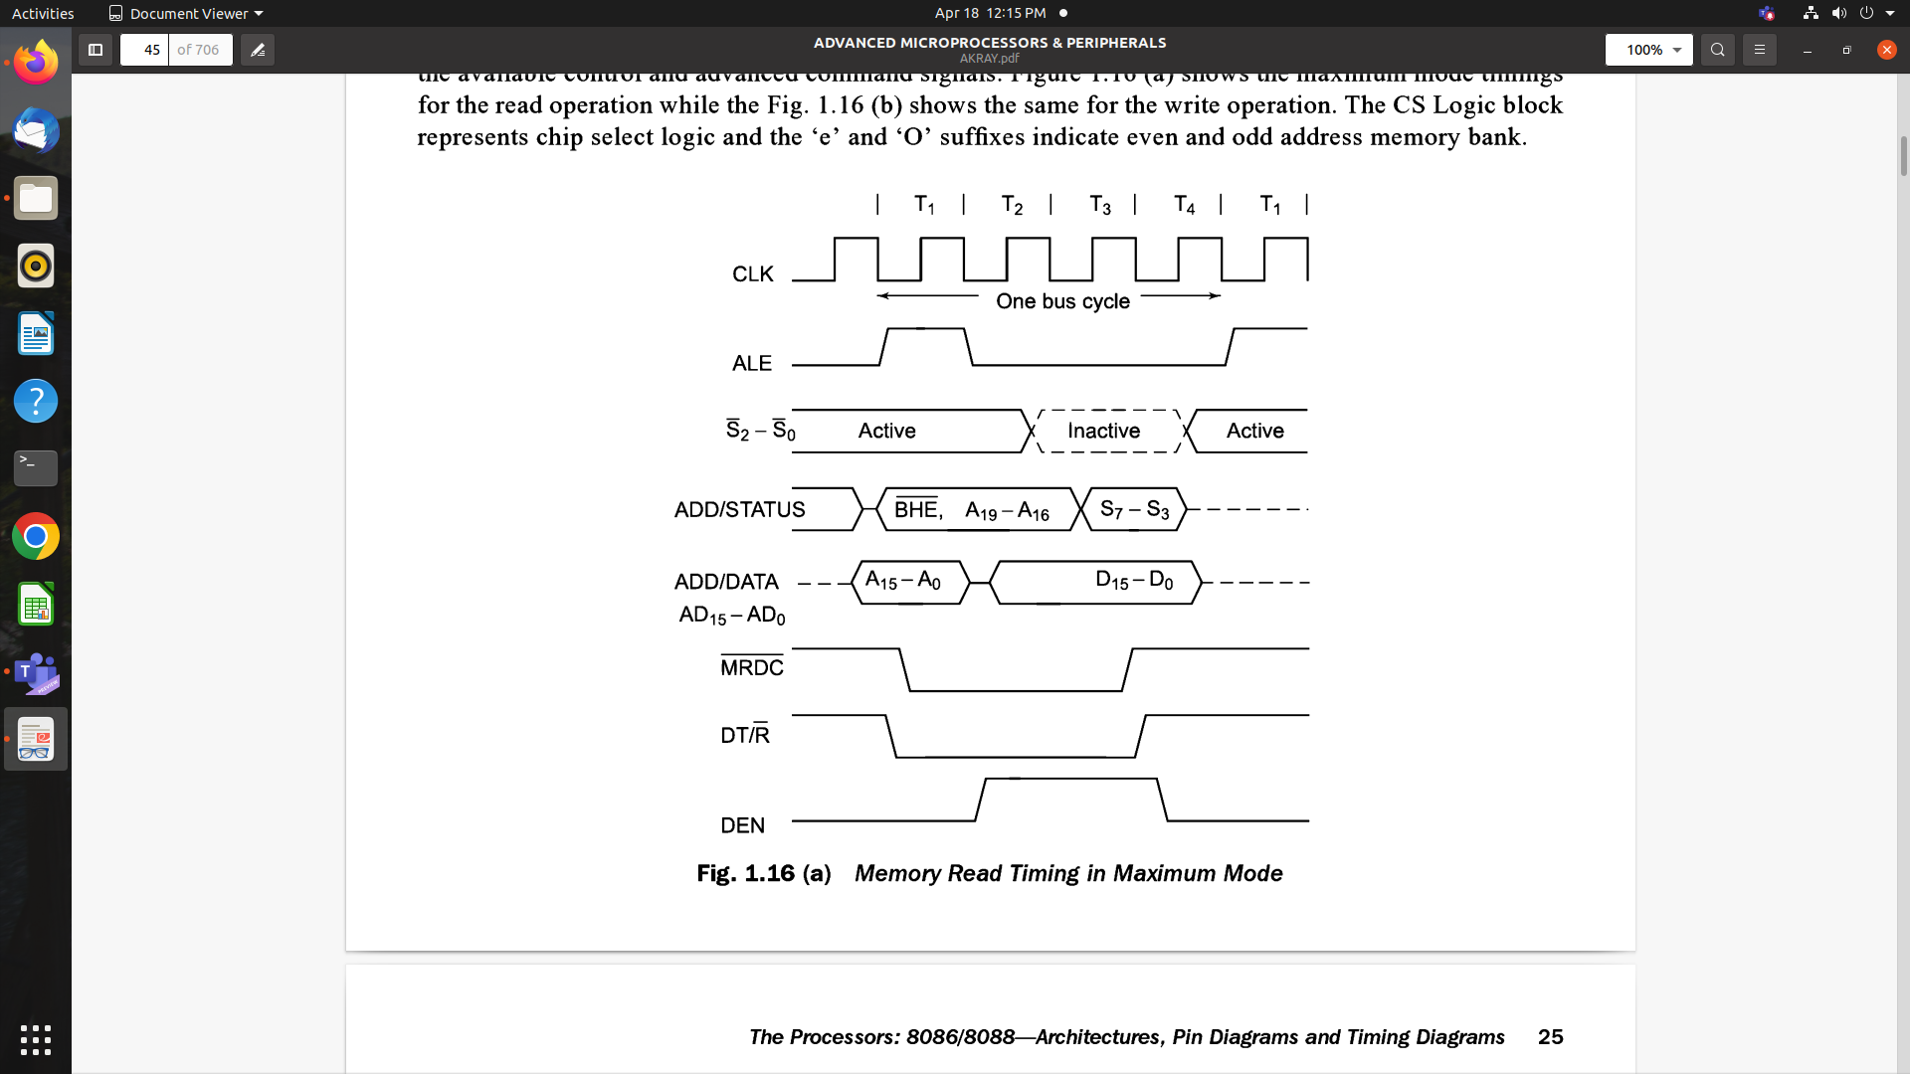

Slide 6
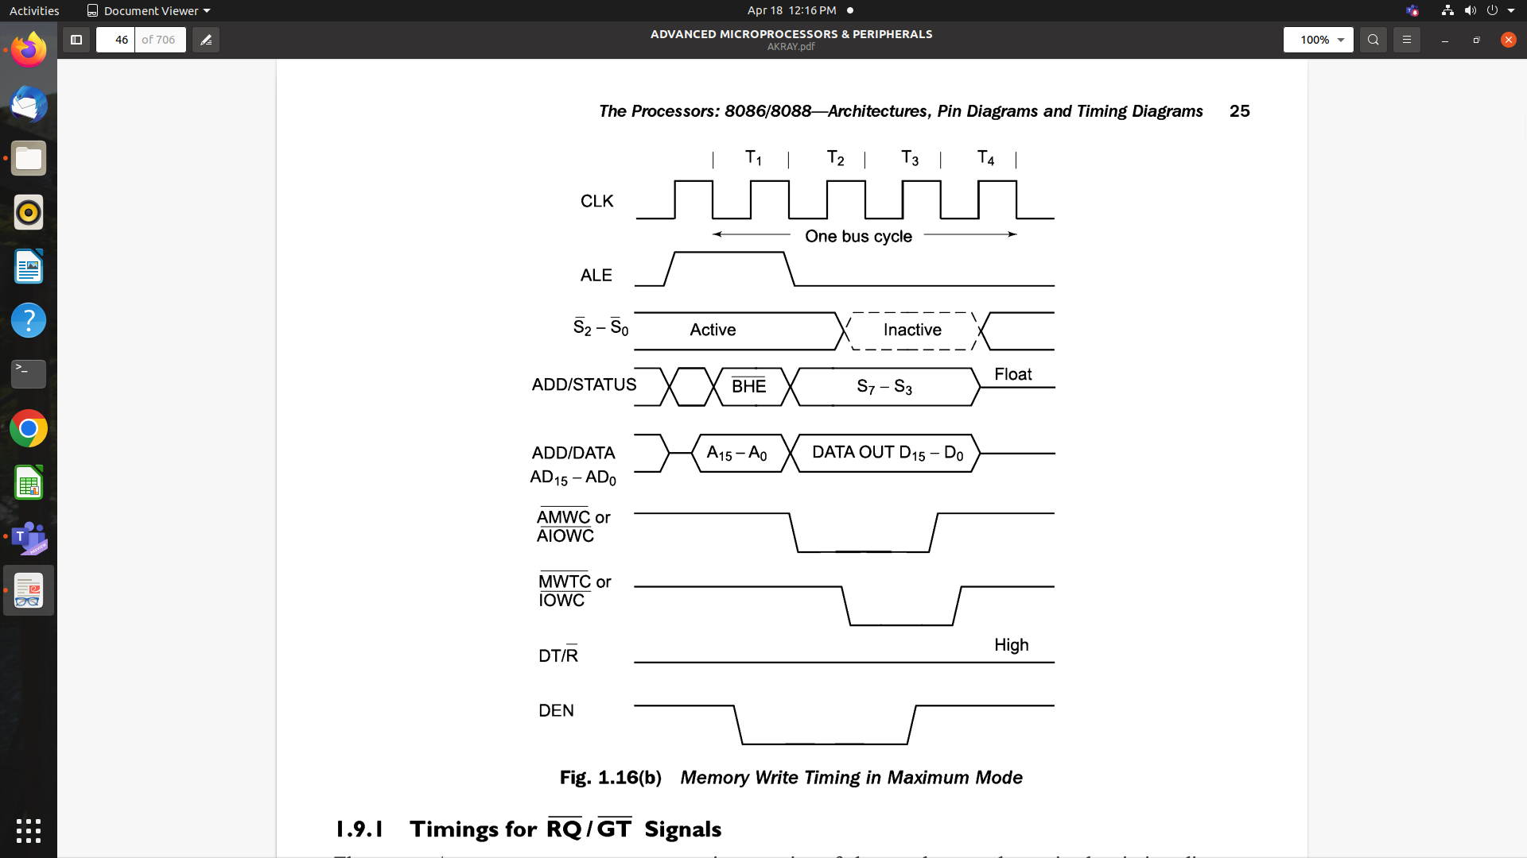

Slide 7
Timings for RQ/ GT Signals
The request / grant response sequence contains a series of 3 pulses.
The request /grant pins are checked at each rising pulse of clock input.
When a request is detected and if the conditions for valid HOLD request are satisfied, the processor issues a grant pulse over the RQ/ GT0 during T4 or T1 state.
When the requesting master receives this pulse, it accepts the control of the bus. The requesting master uses the bus till it requires.
When it is ready to relinquish the bus, it sends a release pulse to the processor (host) using the RQ/GT pin.

